Slide 1
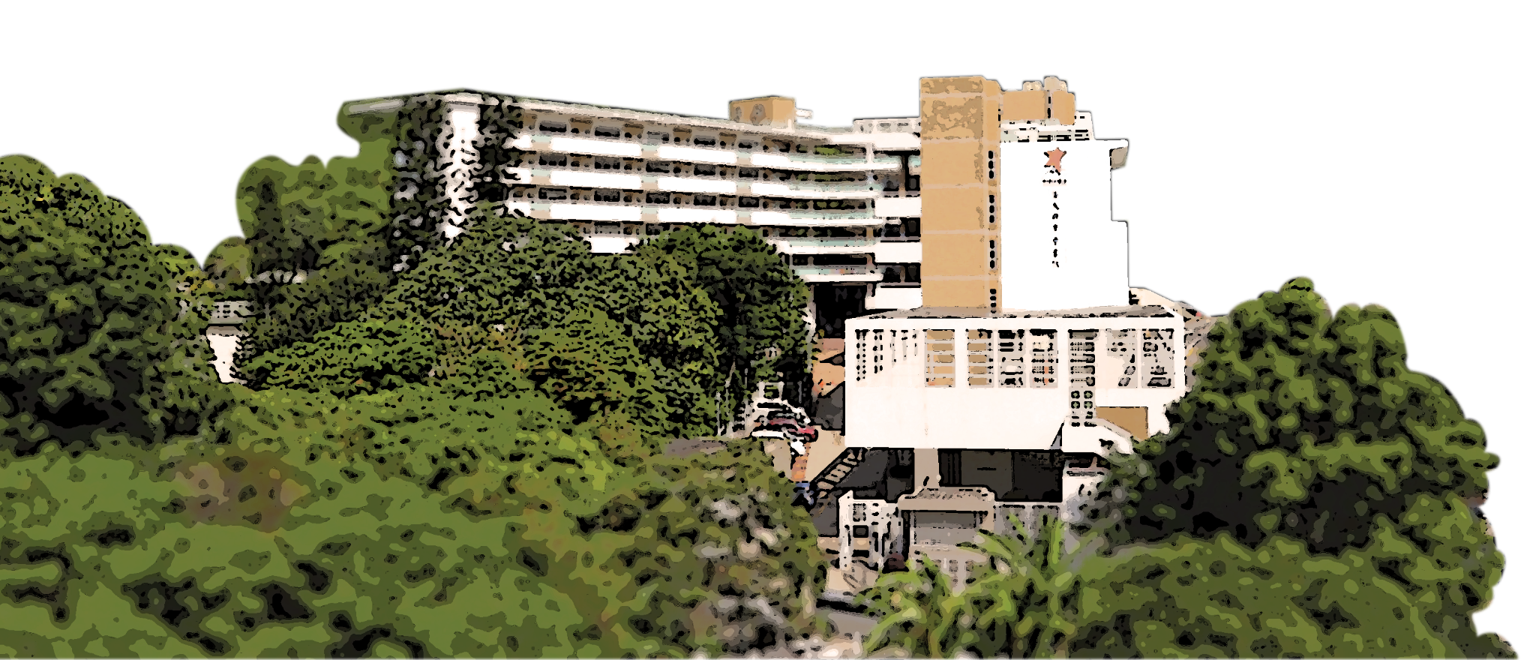
香港學校精神健康教育舆相關危機處理策略

Slide 2
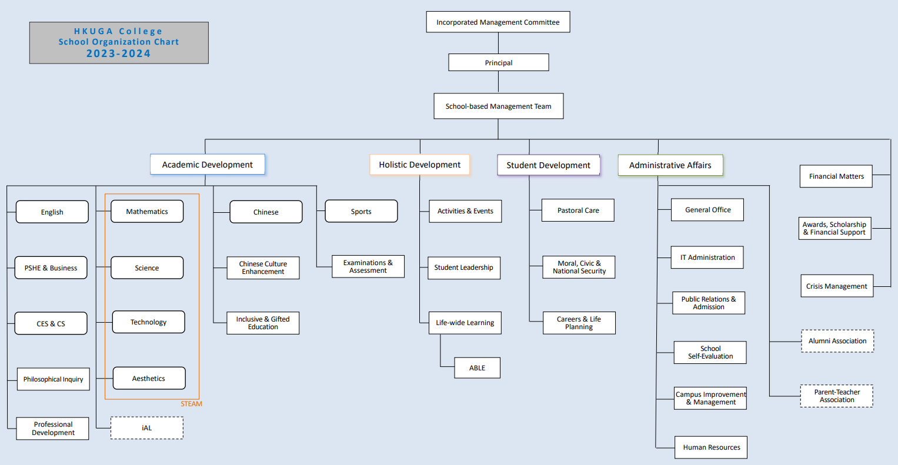

Slide 3
6
WAYS OF BEING
WAYS OF DOING
HEALTH
EMOTIONS
ENGAGEMENT
MEANING
ACCOMPLISHMENT
RELATIONSHIPS
POSITIVE ELEMENTS

Slide 4
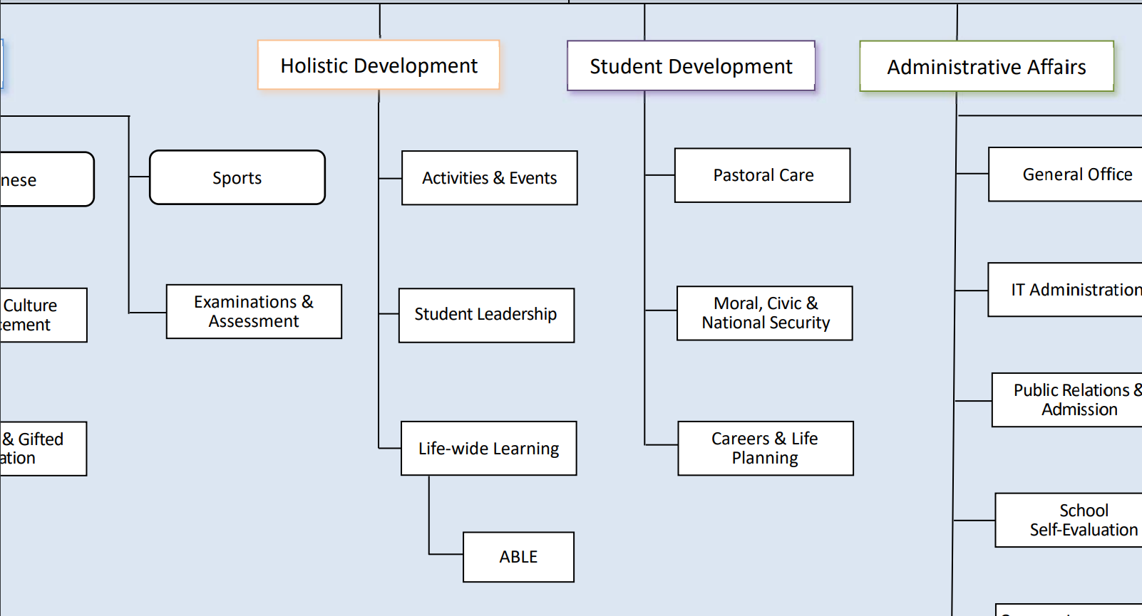

Slide 5
Student Development Committee

Slide 6
Student Development
Pastoral Care (學生關顧及培育)
Career & Life Planning (升學及生涯規劃)
Moral, Civic & National Security Education (德育、公民及國安教育)
‹#›

Slide 7
Major Concerns:
Enhancement of mental health of students & staff
Reestablishment of behaviour expectations
Implementation of national security education
Provision of professional development to teachers related to student care and support
Implementation of the value education curriculum

Slide 8
Major Concerns:
Enhancement of mental health of students & staff
Reestablishment of behaviour expectations
Implementation of national security education
Provision of professional development to teachers related to student care and support
Implementation of the value education curriculum

Slide 9
Strategies:
Whole-school approach to enhancing wellbeing of students
Teachers’ professional development
Home-school collaboration
Introduction of professional support (internal & external) - Care and Support for Students

Slide 10
Whole-school approach to enhancing wellbeing of students

Slide 11
Strengthening on strategies to achieve Wellbeing

Slide 12
Positive Education at HKUGAC since 2017
All teaching staff attended Positive Education seminars / workshops
The school has been promoting ‘wellbeing’ which empowers all students and staff to lead a flourishing life.
Most ‘wellbeing’ activities are organized by HDC, SDC and SBMT
All students have to complete the VIA survey at the beginning of the year.

Slide 13
Strategies
Before Sept 2024 …
all teachers attended Positive Education seminars / workshops
A few committees organized most ‘wellbeing’ activities.
the school has been promoting ‘wellbeing’ through various activities
students had to complete the VIA survey at the beginning of the year.
Students from our own PS are very familiar with the Pos Ed structure and Character Strengths
After Aug 2024 …
Some teachers will continue to attend training in or outside school.
panels and committees will collaborate to organize special events (the informal curriculum) that are related to all six elements of Positive Education and agreed focussed values
the formal curriculum (KLAs and PC lessons) will be revamped to cover all six elements of Positive Education and agreed focussed values
students will set their annual goals and strategies based on their VIA results (character strengths). They will review and evaluate them every year.

Slide 14
Formal Curriculum (Assemblies + PC Lessons)
6 domains across all forms (sample)
Form | Health & Emotions | Engagement & Purpose | Accomplishment | Relationships
S.1 | self-understanding self-care / hygiene understanding our emotions how to release stress how to boost our resilience what is mindfulness strike a balance between health and interests | goal setting management skills (e.g. time, money, self-discipline, study), how to stay motivated and work with purpose how to cope with failures – a growth mindset | leadership training – being a leader and a team member voluntary service careers planning coping with failures and success | sex education (friendship, romance, safety, homosexual, transexual) filial piety, human and animal rights, environmental conservation, national identity understanding our character strengths
S.2
S.3
S.4
S.5
S.6

Slide 15
Informal Curriculum
Collaboration among Panels and Committees
Sports and Music
Moral, Civic and National Security
Careers and Life Planning
Holistic & Student Development Committees
Languages
ABLE
Business
Student Leadership
Science and Technology
Life-wide Learning
Notes:
Any photos to be inserted in the circles?

Slide 16
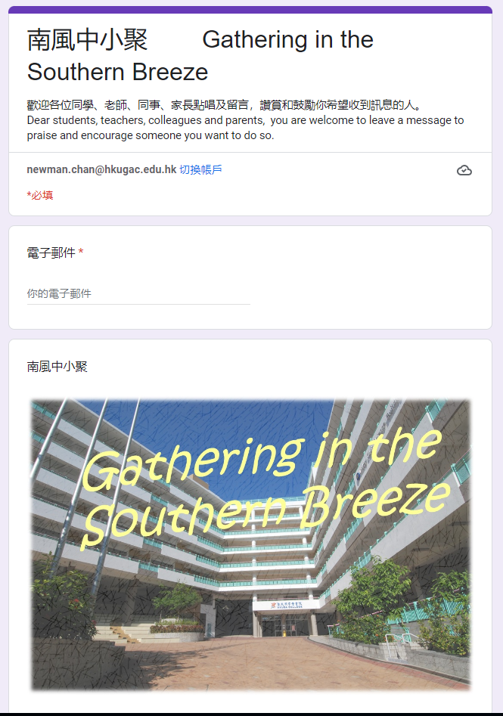
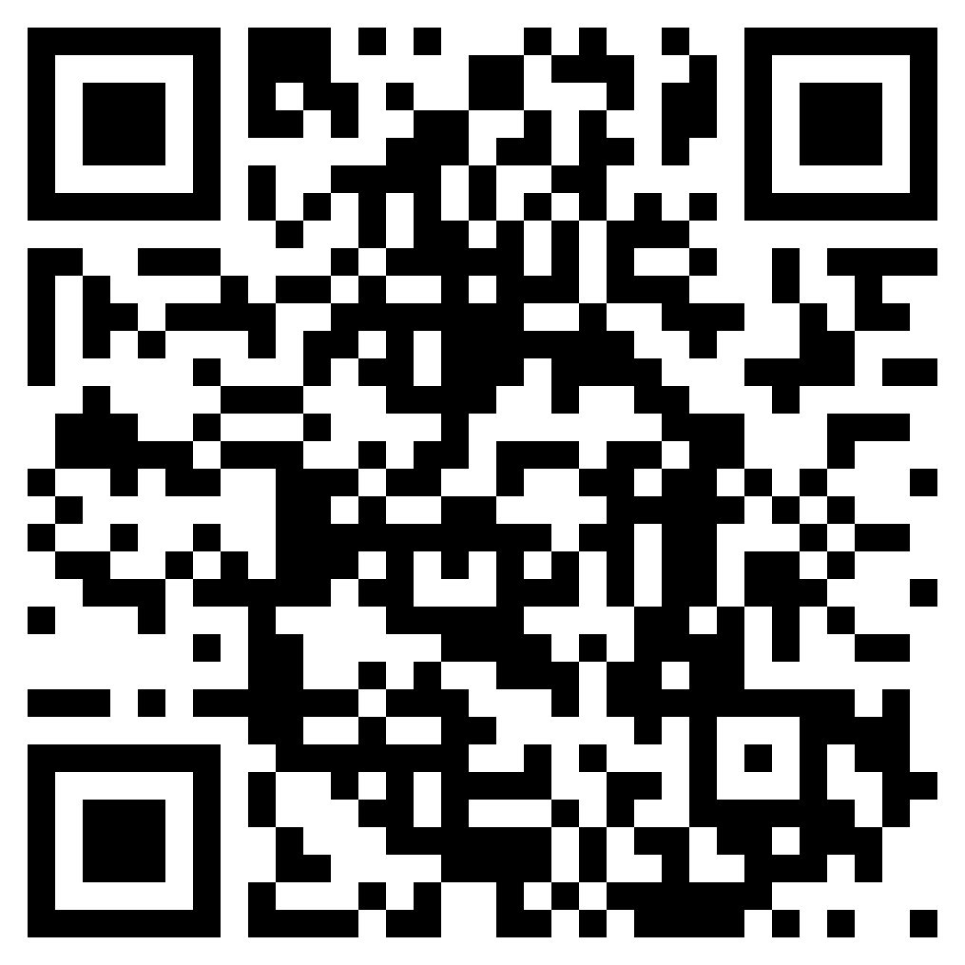
One of the programmes:
https://www.youtube.com/watch?v=2v6K1ssjGR0&list=WL&index=3

Slide 17
Teachers’ professional development

Slide 18
Provision of professional development to teachers related to student care and support
Mental Health First Aid Course for staff
The seminar conducted by The Samaritan Befrienders on “Understanding and prevention of suicideal cases” on PD Day
PD sharing (SEN) in Staff Meeting

Slide 19
Home-School
Collaboration

Slide 20
Meeting with Parents
New S1 Parents Meeting (July)
S1 / S4 Curriculum Nights
S2 / S3 / S5 / S6 (2 times) Parents Nights
Parents Days (Term 1 / 2)
Principal Meeting with Parents (Term 1 / 2)
Parent Talks and Parent Education Programmes

Slide 21
Introduction of professional support (internal & external) - Care and Support for Students

Slide 22
Enhancement of mental health of students & staff
more resources and manpower (e.g. additional social worker, nurse, CP service for students and staff)
pastoral programmes and talks to enhance positive mental health (e.g. talk by Shell and Spines)
lower nos. of student cases

Slide 23
Pastoral Care (學生關顧及培育)
• 2 to 3 Class Teachers (班主任)
• Head of Year (級主任)
• Pastoral Care Phase Leader (學生培育統籌)
• Head of Pastoral Care (副校長)
‹#›

Slide 24
Professional Support (校本專業支援)
• 3 Social Workers (1 employed by school)
• School-based Professional Support
Nurse
Educational Psychologist
Clinical Psychologist
Speech & Hearing Therapist
3 School Counsellors
‹#›

Slide 25
Pastoral Care
Programmes
‹#›

Slide 26
Themes and Goals of Each Year Level (junior)
 | Themes / Objectives
S1 | Adapting, Accepting and Embracing Challenges Ahead Being Responsible, Respectful and Independent. Adapting to the new school and building connections with others. Developing a sense of belonging & ownership to class and school. Building information literacy - be aware of the impacts brought by online behavior.
S2 | Establishing, Reinforcing and Harnessing our Strengths Establishing proper learning and behaviour expectations Developing digital and media literacy Developing better understanding of self and others
S3 | The first stretch - Stretch your potential and become an independent learners Prepare for the NSS elective selection and be a more mature student To be grateful and shows appreciation to the classmates, teachers and school To raise their sense of belongings to nurture students to be responsible and independent To promote the mental health issue, digital literacy and students’ behaviour & expectation.

Slide 27
Themes and Goals of Each Year Level (senior)
 | Themes / Objectives
S4 | Empowering Senior Form Students: Nurturing responsibility and empathy for Positive Engagement Establish students' learning habits and reinforce behavioral expectations as senior form students. Foster the growth of students as respectful, responsible, and empathetic individuals who contribute positively to their class, the College and our society. Provide students with the necessary skills to effectively overcome different challenges and prioritize their well-being.
S5 | Enriching & fostering your skills and opportunities as senior school members To help students re-establish a good learning habit and routine during/ after the pandemic To guide students to set purposeful goals and create opportunities for students to reflect on and celebrate progress To develop students to become caring, agile, responsible and empathetic (“CARE”) members of our community with positive thinking To encourage students to serve their classes, the College and our society by engaging themselves in a range of bonding activities
S6 | The last stretch - stretch your awareness of what’s possible To provide a range of opportunities to empower students as a team to create a meaningful purpose for the graduating cohort To equip students with emotional literacy, thus, increasing their resilience level and improving their wellbeing To prepare students for their university application with their passion in mind

Slide 28
Programme Highlights (S1)
S1 Orientation Programme (Aug 2023)
S1 Sex Education Programme (Oct 2023)
S1 Admission Day Ambassador (Dec 2023)
Emotion check by Class Teachers to students (Jan 2024)
Excursion Week (Mar 2024)
S1 Inclusive game booth (May 2024)

Slide 29
Programme Highlights (S2)
S2 Excursion
Fitness competition
S2gether Micro-Movie competition

Slide 30
Programme Highlights (S3)
Interclass Fitness Competition
S3 Excursion (Guangzhou)
Sex Education Competition

Slide 31
Programme Highlights (S4)
Community service - tutoring primary school students in Tin Shui Wai
A series of sharing sessions to cultivate students’ sense of empathy
Team building activities and career programmes collaborating with different committees/ parties (CLP, IGE, MCNSE, social workers, school counsellors)

Slide 32
Programme Highlights (S5)
Inter-class Lyrics and Meaning Competition
“Brick-through Classroom Lego”

Slide 33
Programme Highlights (S6)
S6 Christmas Show
Stress Management Activity organized by Student Counsellors
Grooming Etiquette (Workshop conducted by a designer)
Last School Day Activities

